Slide 1

BIO103 Lab (1 credit hour) FALL 2025
Dept. of Biochemistry & Microbiology

Slide 2


WEAR LAB COAT
WEAR CLOSED SHOES
TIE UP LONG HAIR

Slide 3
Experiment 1
Handling of a Light Microscope and Visualization of Prepared Slides

Slide 4
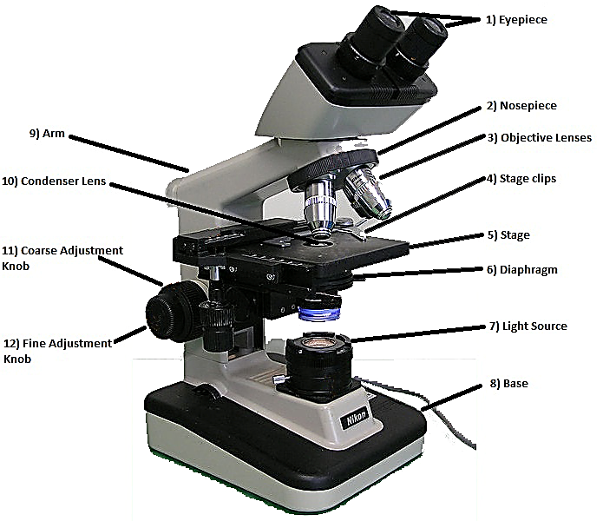

Slide 5
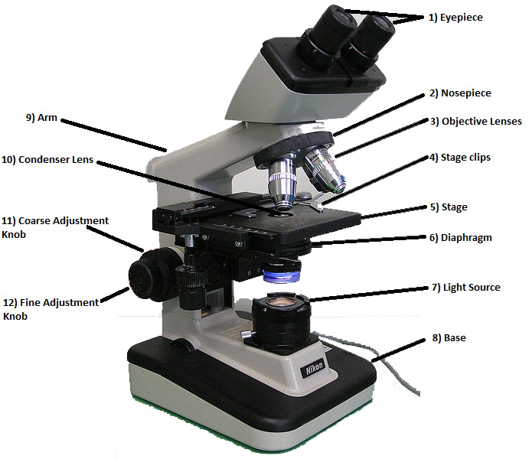
Handling of a Light Microscope and Visualization of Prepared Slides
The light microscope is an instrument for visualizing fine detail of an object.
To know about microorganisms, the cell should be observed first and to observe the cell microscope is required.
With the high-power objective lens the shape, color and arrangement of the cell can be observed.
Microscopes can be separated into several different classes.
Light or optical microscope
Electrons microscope
Figure: A light microscope

Slide 7
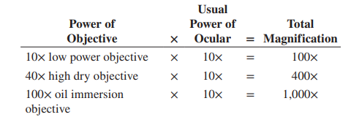
Parts of a light microscope
Eyepiece: It contains the ocular lens, which provides a magnification power of 10x to 15x, usually. This is where you look through.
Nosepiece: It holds the objective lenses and can be rotated easily to change magnification.
Stage clips: These hold the slide in place.
Stage: It is a flat platform that supports the slide being analyzed.
Objective lenses: Usually, there are three or four objective lenses on a microscope, consisting of 4x, 10x, 40x and 100x magnification powers. In order to obtain the total magnification of an image, you need to multiply the eyepiece lens power by the objective lens power. So, if you couple a 10x eyepiece lens with a 40x objective lens, the total magnification is of 10 x 40 = 400 times.

Slide 9
Parts of a light microscope
Diaphragm: It controls the intensity and size of the cone light projected on the specimen. As a rule of thumb, the more transparent the specimen, the less is the light required.
Light source: It projects light upwards through the diaphragm, slide and lenses.
Base: It supports the microscope.
Arm: It supports the microscope when carried.
Condenser lens: It helps to focus the light onto the sample analyzed. They are particularly helpful when coupled with the highest objective lens.
Coarse adjustment knob: When the knob is turned, the stage moves up or down, in order to coarse adjust the focus.
Fine adjustment knob: The knob is turned to fine adjust the focus.

Slide 10
Rules for using Microscope
Always begin focusing with the 4X objective.
Use immersion oil ONLY with the 100X objective (oil immersion lens). Oil immersion is essential for viewing individual bacteria.
Use only a single DROP of oil.
Remove the slide from the stage when you are done.
ALWAYS clean immersion oil off the objective when you are done using the microscope. Use a Kim wipe or lens paper to clean the objective.
Always place the 4X objective over the stage aperture and ensure that it is as far above the stage as possible before putting the microscope away.
If the microscope is dirty or in the wrong place, tell your instructor or the lab assistant.

Slide 11
Microscopic observation of stained cell
The purpose of this experiment is to use a compound microscope for the visualization of cellular morphology from permanent-stained slides of microbes.
Microbiology is the study of all living organisms that are too small to be visible with naked eye.
Normally microorganisms are transparent and have approximately the same refractive index of the air, so it is difficult to see them. With the high-power objective lens the shape, color and arrangement of the cell can be observed.
To prevent difficulties staining is important after which the organisms get a different refractive index which makes a contrast between air and the cells.
Microorganisms are divided into Bacillus (rod shaped), Coccus (spherical) and Spirillum (curved) on the basis of shapes.
Notes:
refractive index, also called index of refraction, measure of the bending of a ray of light when passing from one medium into another. ... Refractive index is also equal to the velocity of light c of a given wavelength in empty space divided by its velocity v in a substance, or n = c/v.

Slide 12
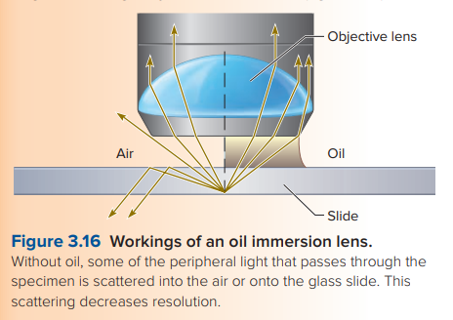
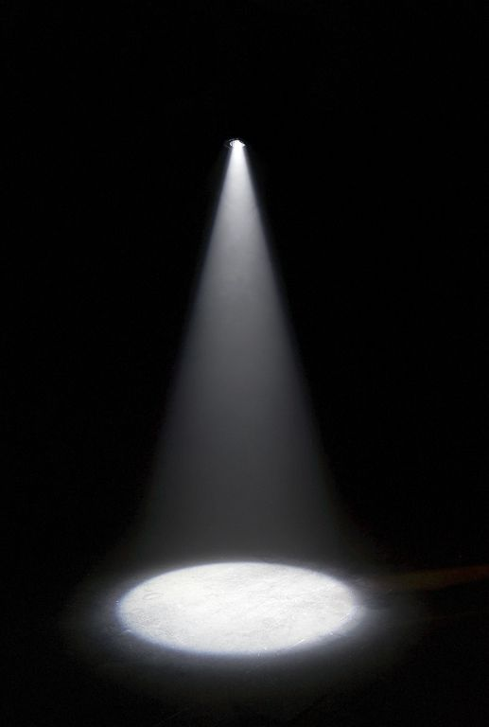
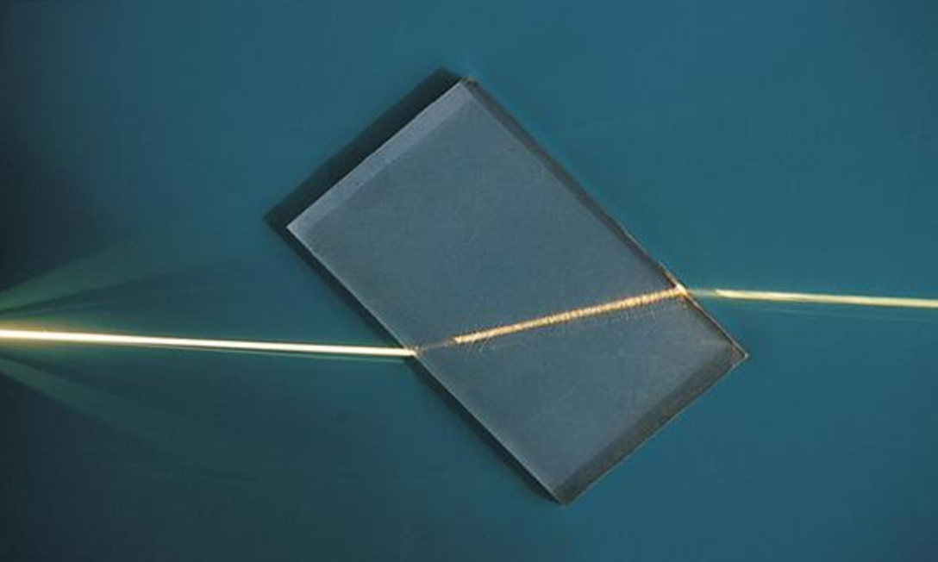
Refraction of light
Spotlight focuses the light onto something just like Condenser lens.

Slide 13
Methods and Materials
Procedure
We have already reviewed the instructions for the use of the microscope, giving special attention to the use of the oil immersion objective lens. Refer to those instructions for viewing the prepared slides.
Observe the shapes and the relative sizes of the cells under the high-power lens and oil immersion objectives. Refer to the “Notes” section to learn about the organisms.
Materials
Compound microscope
Slide
Cotton
Ethanol

Slide 14
VIRTUAL MICROSCOPE
https://www.ncbionetwork.org/iet/microscope/

Slide 15

Microscopic observation of Prokaryotic cells

Slide 16
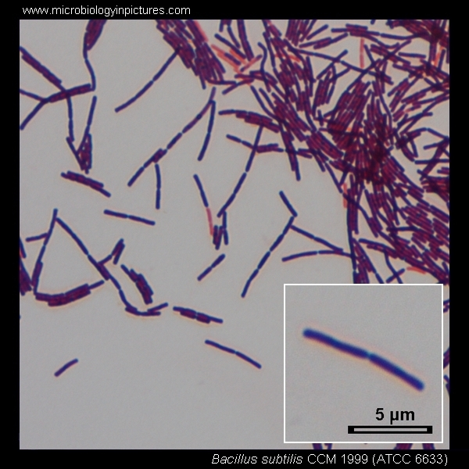
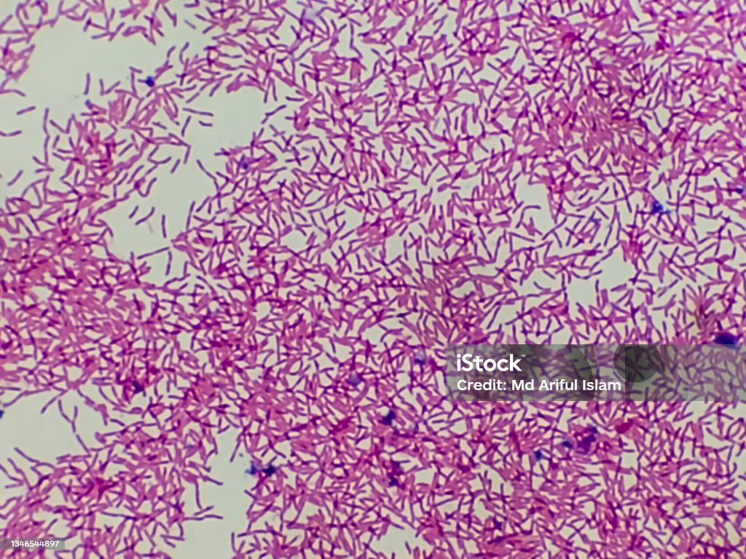
Microscopic observation of Prokaryotic cells
Bacillus subtilis
Escherichia coli

Slide 17
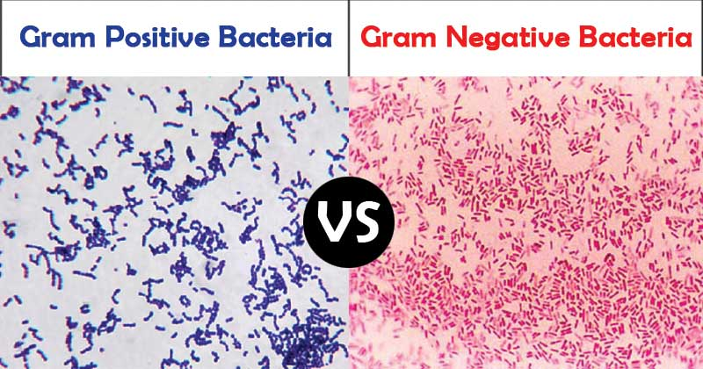
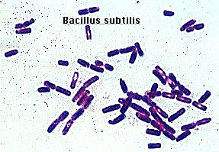
Microscopic observation of Bacillus subtilis
Bacillus subtilis (Gram-positive)
Scientific classification:
Kingdom: Eubacteria
Family: Bacillaceae
Genus: Bacillus
Species: B. subtilis
Characteristics: Bacillus subtilis, commonly abbreviated B. subtilis, is a Gram-positive, rod-shaped (about 4-10 micrometers long) bacterium that is commonly found in soil and the gastrointestinal tract of ruminants, humans, and marine sponges. B. subtilis reproduce by binary fission and able to produce endospore during unfavorable conditions. B. subtilis is considered the best studied Gram-positive bacterium and a model organism to study bacterial chromosome replication and cell differentiation. It is one of the bacterial champions in secreted enzyme production and used on an industrial scale by biotechnology companies.

Slide 18
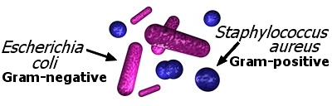
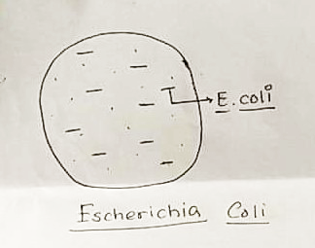
Microscopic observation of Escherichia coli
Escherichia coli (Gram-negative)
Scientific classification:
Kingdom: Eubacteria
Family: Enterobacteriaceae
Genus: Escherichia
Species: Escherichia coli
Characteristics: Escherichia coli, commonly abbreviated E. coli, is a Gram-negative, rod-shaped bacterium that is commonly found in the lower intestine of warm-blooded organisms (endotherms). Most E. coli strains are harmless, but some serotypes can cause serious food poisoning in humans and are occasionally responsible for product recalls due to food contamination.
Fig: Escherichia coli

Slide 19
Microscopic observation of Eukaryotic cells

Slide 20
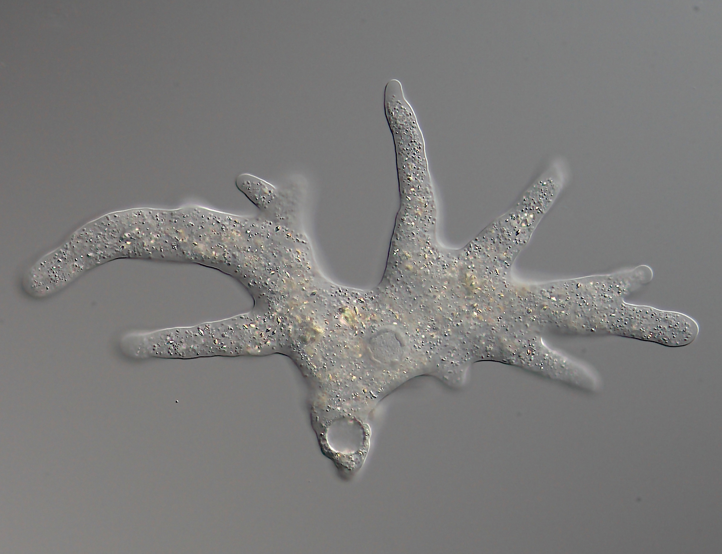
Microscopic observation of Amoeba proteus
Amoeba eats Paramecia
https://www.youtube.com/watch?v=mv6Ehv06mXY

Slide 21
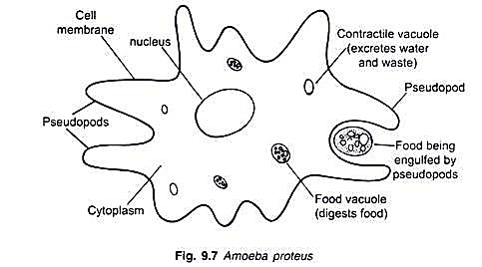
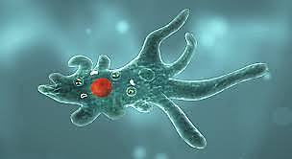
Microscopic observation of Amoeba proteus
Amoeba proteus
Scientific classification:
Kingdom: Protista
Family: Amoebidae
Genus: Amoeba
Species: Amoeba proteus
Characteristics: Amoeba is unicellular, eukaryotic, and has no cell wall. It reproduces by binary fission and moves with the help of pseudopodia. Feeding is done by phagocytosis, similar to our phagocytic white blood cells (WBC).
Fig: Amoeba proteus

Slide 22
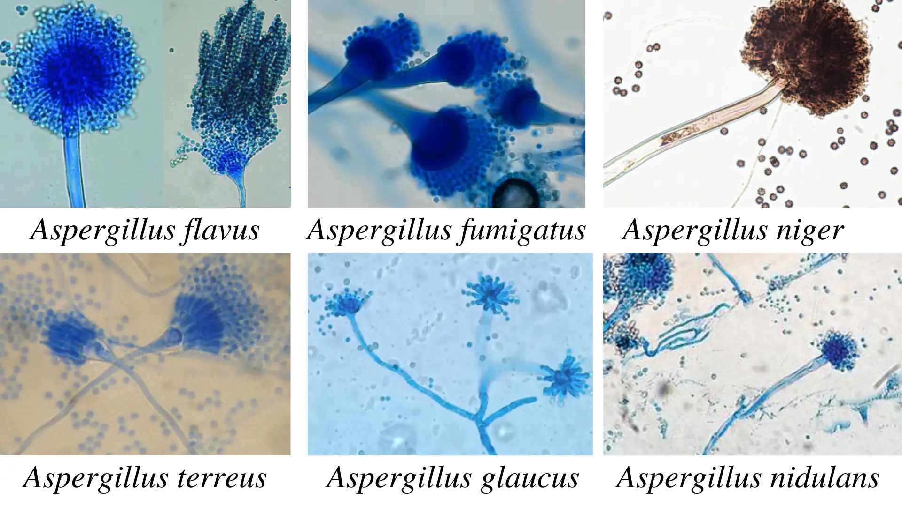
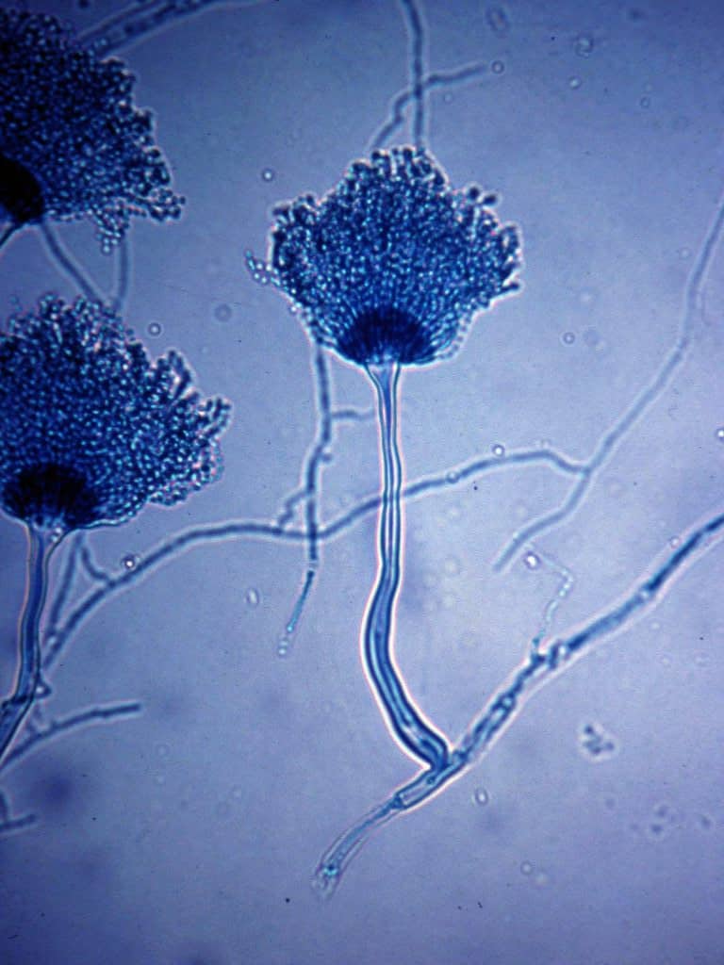
Microscopic observation of Aspergillus spp.
https://microbeonline.com/aspergillus-morphology-clinical-features-and-lab-diagnosis/

Slide 23
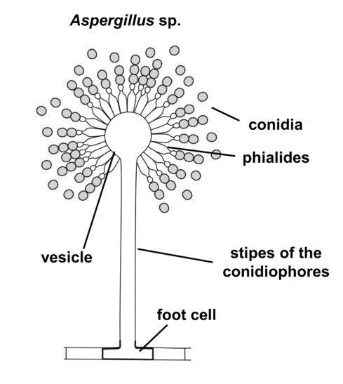
Microscopic observation of Aspergillus spp.
Aspergillus is a fungal genus consisting of a few hundred mold species found in various climates worldwide.
Aspergillus spp. are common contaminants of starchy foods (such as bread and potatoes) and grow in or on many plants and trees.
Under a light microscope, Aspergillus can be identified by the presence of 'T' or 'L' shaped 'foot cells' in the mycelium that produce a single conidiophore perpendicular to the long axis of the cell.
The conidiophore enlarges at its apex to form a round-shaped vesicle. The fertile area of the vesicle gives rise to a layer of cells called phialides that produce long chains of asexual spores named conidia or conidiophores.
Mycelium
Fig: Aspergillus spp.

Slide 24
Microscopic observation of human blood cells

Slide 25
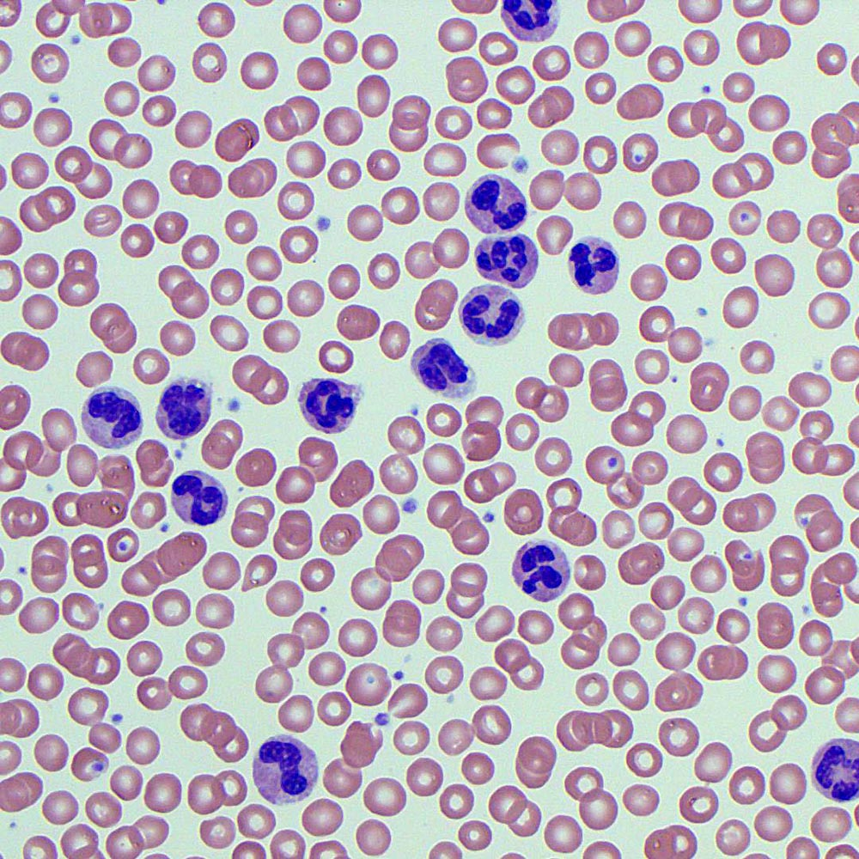
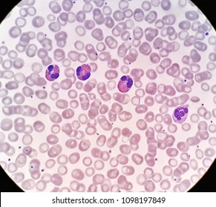
Microscopic observation of human blood cells
https://medschool.co/tests/blood-film/neutrophil-morphology
Neutrophils
Eosinophils

Slide 26
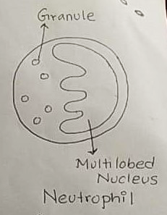
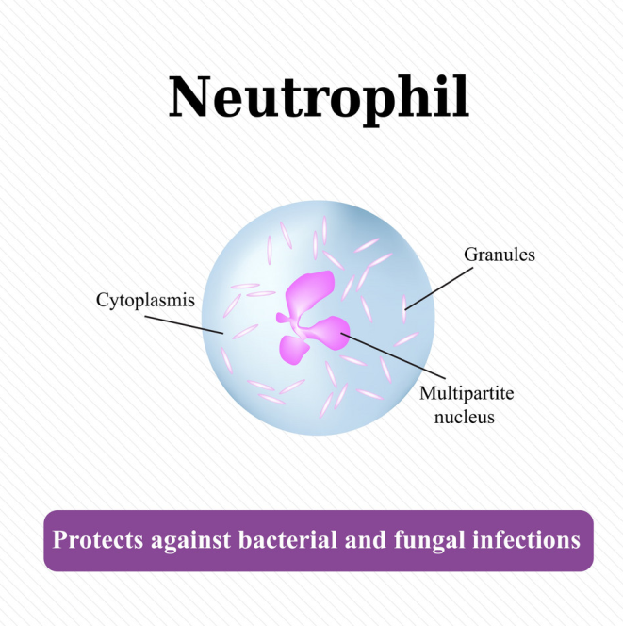
Microscopic observation of Blood cells
Blood cell: Neutrophils
Neutrophils are one of the classes of white blood cells or leukocytes.
Neutrophils are major cellular component of the innate immune system. In a healthy human, 40-75% of the total white blood cells are neutrophils.
Neutrophils are also called 'polymorphonuclear cells.' The neutrophil nucleus has a complex, lobulated shape. In a cross-section, neutrophils may even look like they have more than one nucleus.
Multi-lobed nucleus (purple stained) and granules in the cytoplasm (neutral pink stained) are two identifying characteristics of neutrophil under a light microscope.
They kill invading pathogens by engulfing them in a specialized process called ‘Phagocytosis.’ Their granules in the cytoplasm contain antimicrobial substances, which are released to kill pathogens.

Slide 27
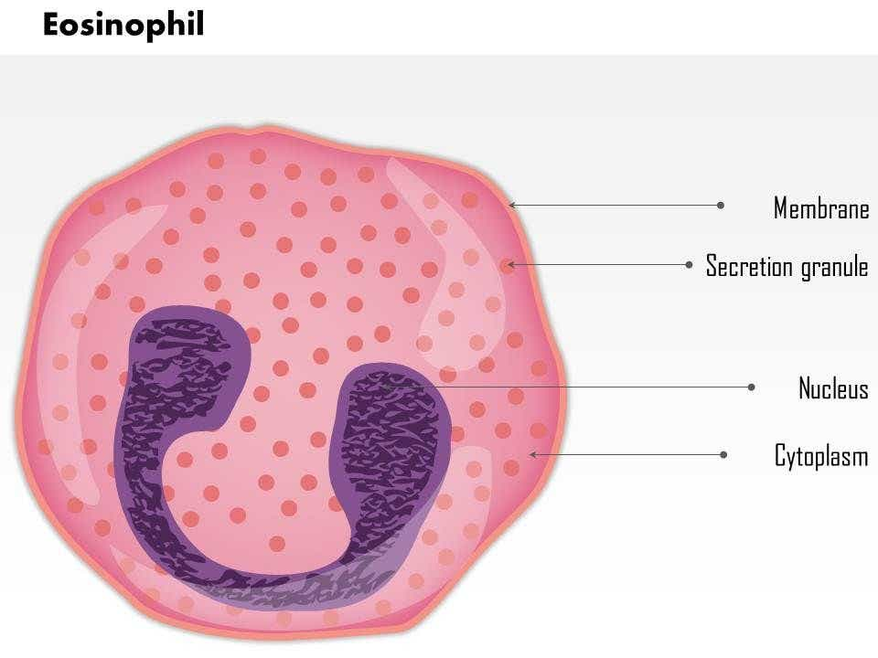
Microscopic observation of Blood cells
Blood cell: Eosinophils
Eosinophils are one of the classes of white blood cells or leukocytes.
In a healthy human, less than 1% of the total white blood cells are eosinophils. Eosinophils, along with basophils and neutrophils, constitute a group of white blood cells known as granulocytes.
Eosinophils are eosinophilic or “acid-loving” due to their large acidophilic cytoplasmic granules. They are about 12-17 micrometer in size, and their nucleus exists as two non-segmented lobes (bilobed nuclei
Eosinophils are actively motile and phagocytic and participate in hypersensitivity (allergic) reactions. Eosinophils are also involved in defense against parasites.

Slide 28
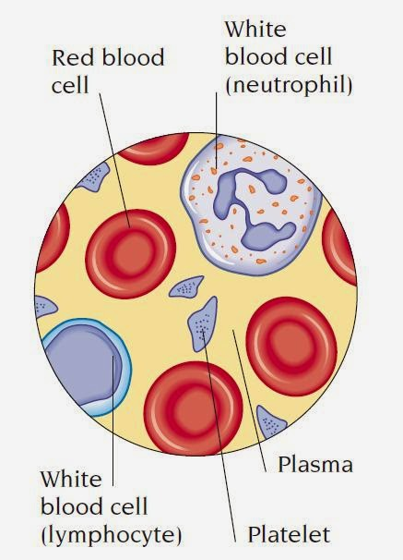
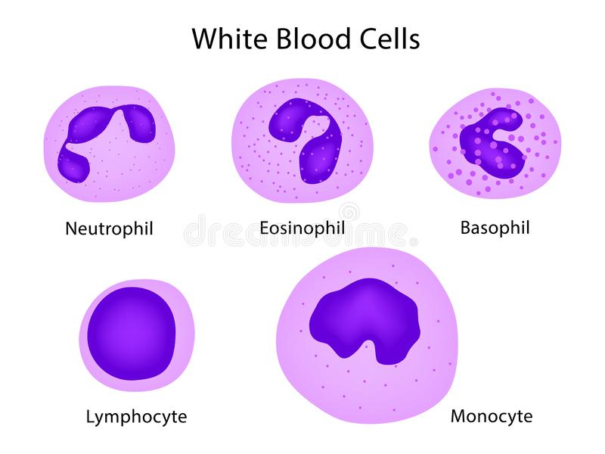

Slide 29
Thank you!

